Slide 1
SolUnesco
Solar Power Southeast
Clean Power Plan: How Will Solar Continue to Thrive in the Southeast After the Supreme Court’s Stay?

Slide 2
SolUnesco
Launched to consolidate the development of multiple projects and to advance Community Solar
Utility-scale solar development: real estate developer for large scale solar
Community Energy: positioned to develop Community Solar model in VA
Real estate investor: land with attractive renewable energy lease
3-4 year goal: $50 million revenue company
Management Team
Four plus decades of -
utility plant management
energy project development
corporate leadership
Construction experience
Delivered over 1GW of power generation projects and 15 MWs of solar generation
Lead solar policy and and legislative efforts in the mid-Atlantic and Virginia for the last five years

Slide 3
Mass vs Rate Compliance
Distributed Generation in Virginia
NPV: 8%, 30 Years
 | Cash | $ (1,689)
 | Home Equity | $ (656)
 | PPA | $ 391
Years Payback
 | Cash | 15.21
 | Home Equity | 18.58
 | PPA | NA
Utilities & Coops engaged in off-session policy discussions with utilities: long-term planning horizon, economics, development process, community solar, & related.
Assumptions: 5kW; Rate Dominion GS1; Home Equity: 5.8%, 10 year term; PV install + soft = 2.90; scale economies: 15%

Slide 4
Mass vs Rate Compliance
VA Creating a New Market Structure?
Through 2015 less than 30 MW plus 90 MWs in 2016
Legislator → 500 MWs in public interest and provided rate recovery, Dom = 400 MWs
Current Dom IRP plans for 1 to 7 GWs
Dominion publically supports planning for CPP
Utility-scale solar: 136 MW under review, PJM queue = 1 GW, & Distribution queue 1.4 GW?
IRS PLR: Allowed Market Index in lieu of Cost of Service
Hearing Examiner supports 56 MWs and the Market Index
Notes:
27.7 MWs TOTAL through Q3 2015
Q3 of 2015 20 MWs net metered solar installed
with an average system size of 7.3 kW.
2 MW installation at Norfolk Naval Base.
Dominion’s Solar Partnership Program 30 MWs authorized
4.5 MWs through the end of 2015
9 MWs projected for 2016.
Per Dominion: projected 16 MWs within the $80 million budget.
Dominion’s Solar Purchase Program = 1.2 MWs.
Coops:
ODEC 30MWs
BARC 0.5 MWs

Slide 5
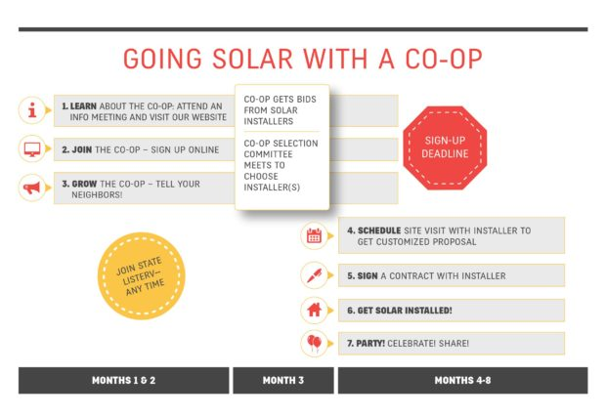
Mass vs Rate Compliance
Creative Procurement Practices - Solarize
Notes:
27.7 MWs TOTAL through Q3 2015
Q3 of 2015 20 MWs net metered solar installed
with an average system size of 7.3 kW.
2 MW installation at Norfolk Naval Base.
Dominion’s Solar Partnership Program 30 MWs authorized
4.5 MWs through the end of 2015
9 MWs projected for 2016.
Per Dominion: projected 16 MWs within the $80 million budget.
Dominion’s Solar Purchase Program = 1.2 MWs.
Coops:
ODEC 30MWs
BARC 0.5 MWs

Slide 6
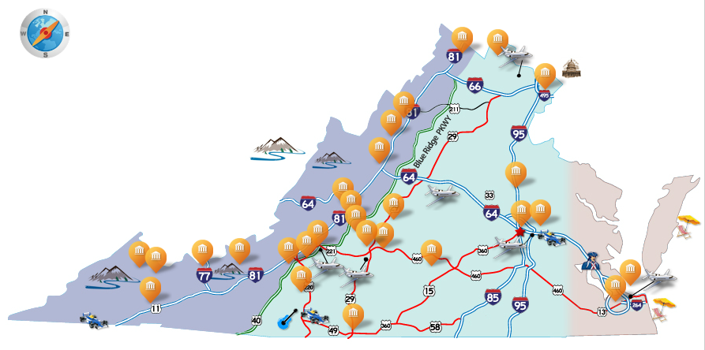
Mass vs Rate Compliance
Creative Procurement Practices - CICV
Convener Enables Regional Collaboration
Independent Solar Expert Represents Buyers & Provides Due Diligence
15 Colleges Leverage Collective Purchasing Power
Round 1 Procurement
15 Colleges for 37+ MW
Round 2 Procurement
? Colleges for ? MW
Round 3
Notes:
27.7 MWs TOTAL through Q3 2015
Q3 of 2015 20 MWs net metered solar installed
with an average system size of 7.3 kW.
2 MW installation at Norfolk Naval Base.
Dominion’s Solar Partnership Program 30 MWs authorized
4.5 MWs through the end of 2015
9 MWs projected for 2016.
Per Dominion: projected 16 MWs within the $80 million budget.
Dominion’s Solar Purchase Program = 1.2 MWs.
Coops:
ODEC 30MWs
BARC 0.5 MWs

Slide 7
CPP provides many trading options and choices for the states
Rate Based Compliance
Mass Based Compliance
R1 Solo
BB
M2 Solo or
Multi-State
AA
CC
Model
Rule
M1 Solo or
Multi-State
R2 Multi-State
JJ
MM
R2 Solo
EE
M4 Solo
DD
FF
Model
Rule
KK
LL
R3 Multi-State
R3 Solo
GG
II
HH
Not Allowed
M3 Solo
Source: Sarah Jackson and Patrick Knight (September 22, 2015) Synapse Energy Economics, Tricks of the Trade: Who Can Sell Emissions Credits to Whom in the Clean Power Plan (Part 2 of 2)

Slide 8
2-3 decades of experience with emission trading
1970s
New source offset
Acid Rain Program
1980s
Lead phase out
1990s
Source: EPA (January 11, 2016), The Clean Power Plan, Emission Trading 101: Introductory Concepts of Mass- and Rate-based Emission Trading Programs Webinar
OTC No_{x} Budget
REC-LAIM
RPS
2000s
No_{x} Budget
RGGI
CA AB32
2010s
CAIR
RFS
CSAPR
1990 Clean Air Act
Carbon Cap & Trade

